Slide 1


Sentimental Analysis
-ABHISHEK

Slide 2

Sentimental Analysis – twitter DataSet

Slide 3

Data Collection
The first step in the sentiment analysis project is to collect customer feedback data
This can be done through various channels, such as social media platforms, online review websites, or customer surveys
This involves removing irrelevant information, such as URLs and hashtags, and converting the text into a format that can be easily analyzed by the model

Slide 4
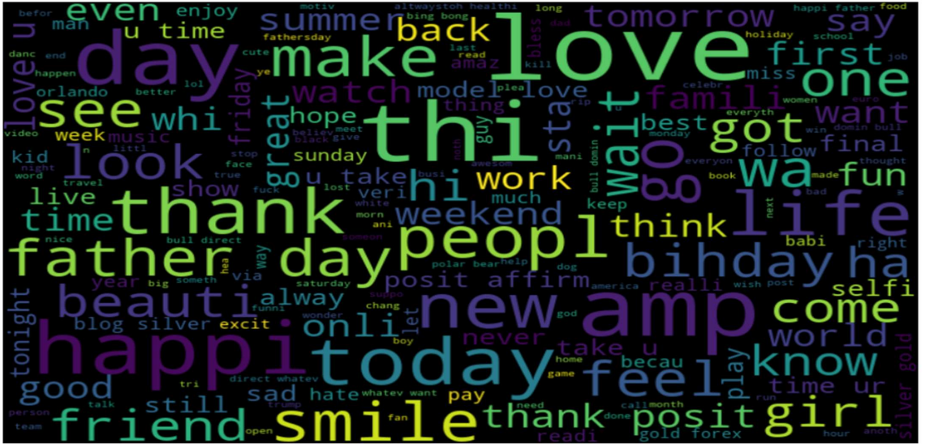
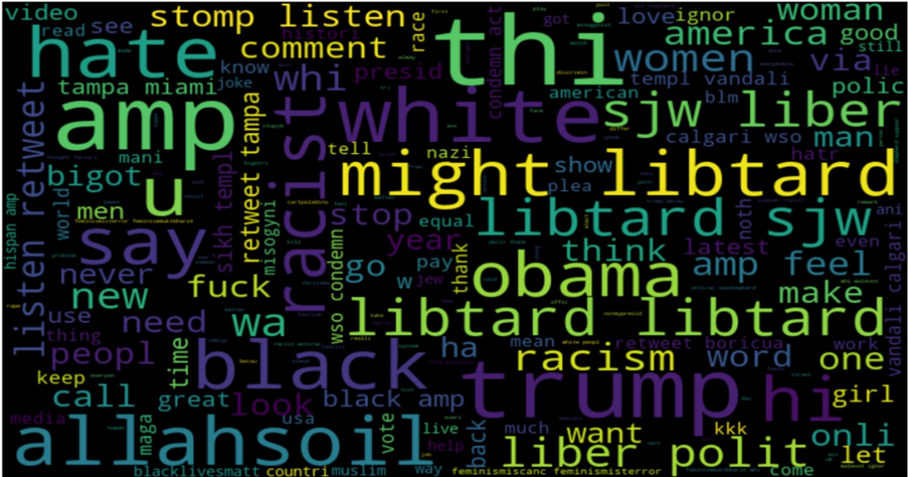
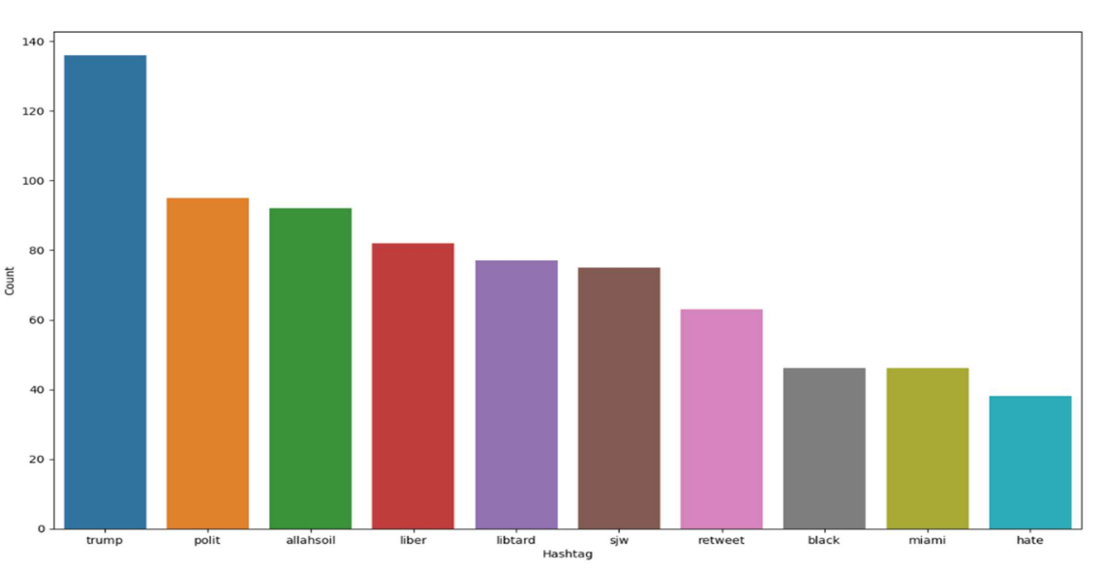
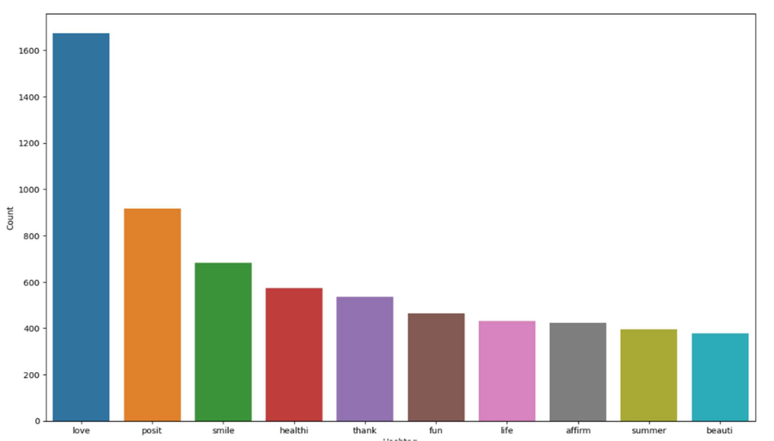
Data Analysis

Slide 5
Model Selection
Logistic regression:
This type of statistical model (also known as logit model) is often used for classification and predictive analytics. Logistic regression estimates the probability of an event occurring, such as voted or didn't vote, based on a given dataset of independent variables.
Naïve Bayes classifier
The Naïve Bayes classifier is a supervised machine learning algorithm, which is used for classification tasks, like text classification. It is also part of a family of generative learning algorithms, meaning that it seeks to model the distribution of inputs of a given class or category.

Slide 6

Model Training
This involves using machine learning algorithms to analyze the text data and identify patterns that correspond to positive, negative, or neutral sentiments
Using Model.fit(x_train,Y_train)
Training model using train data

Slide 7

Evaluation
Once the sentiment analysis model has been trained, it needs to be evaluated to measure its accuracy.
There are various metrics that can be used to evaluate the performance of the sentiment analysis model, such as precision and F1 score
These metrics provide insights into the strengths and weaknesses of the model and can help improve its accuracy and performance

Slide 8
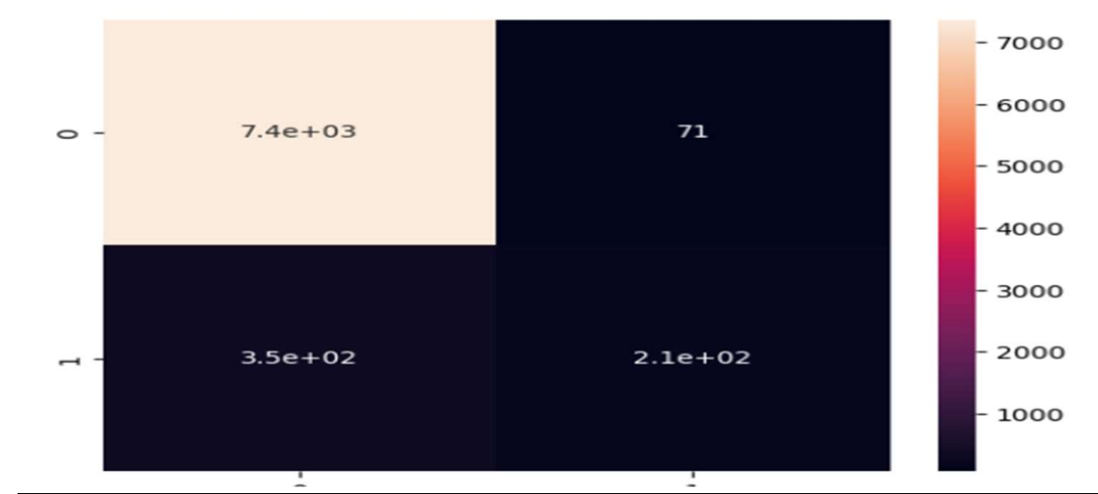
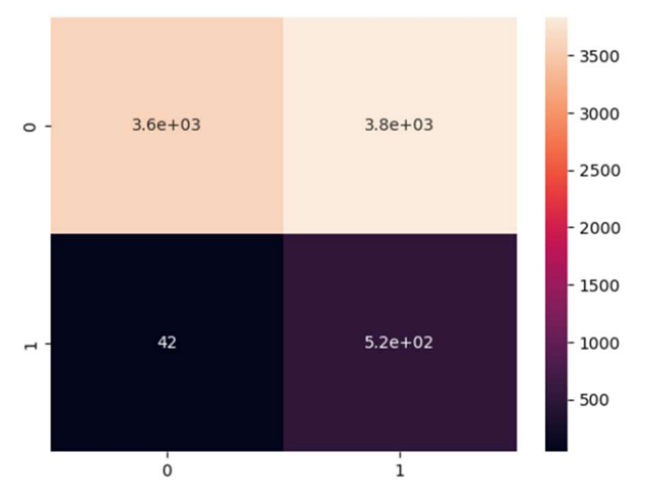
Confusion Matrix

Slide 9
Conclusion
In conclusion, sentiment analysis is a powerful tool for analyzing customer feedback and gaining insights into their sentiments towards a product or service
An accuracy of 0.94 in logistic regression and 0.51 in Naive Bayes for sentiment analysis indicates that the logistic regression model is performing better than the Naive Bayes model.

